Slide 1
CPE 404
Computer Hardware Design
Dr Osama Hosameldeen
Spring 2021
Lecture 9
Register Transfer Operations

Slide 2
Topics
Data Paths and Operations
  The Arithmetic/Logic Unit
Register Transfer Operations
  Micro-Operations
Multiplexer-Based Transfer
Bus-Based Transfer
Complete Data Path Design
Pipelining
Notes:
School of Engineering

Slide 3
CPU: Main Parts

Slide 4
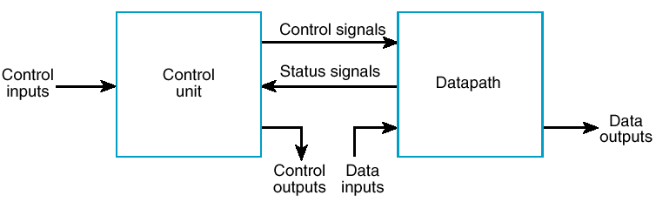
Parts of the CPU
Datapath consists of:
  Registers, Multiplexors, Adders, Subtractors and logic to perform operations on data (Comb Logic)
Control Unit
  Generates signals to control data-path
  Accepts status signals to perform sequencing
  Accepts inputs from the user (Go, start).. switch
Control
Data Path

Slide 5
Micro-Computer System
Micro-computer System =
Control Unit +
Data Path +
Memory +
Input/Output
CPU
MEMORY
Input and Output

Slide 6
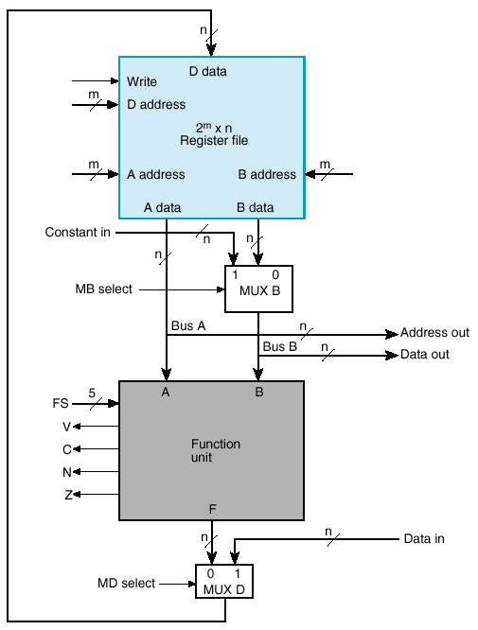
Data Path
We will first design the Function Unit (or ALU)
We will then show how a register file is designed.
Finally, we will create the complete data path by integrating the ALU with the Register File.
Memory

Slide 7
ALU Design

Slide 8
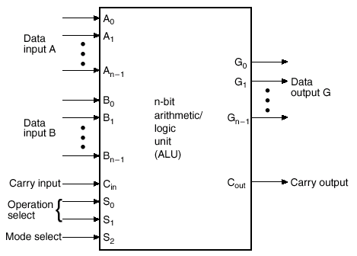
Arithmetic Logic Unit (ALU)
The ALU is a combinational circuit that performs a set of basic arithmetic and logic operations.
  An adder can perform addition, subtraction, …
  Logic unit can perform
  AND, OR, NOT … operations
  Select lines are used to determine the operation to be performed.

Slide 9
ALU Design: Using Hierarchy
The ALU will have:
  2 control lines S₀,S₁ for operation selections (+/-)
  1 control line S₂ to select logical versus arithmetic operations
Start designing in parts

Slide 10
Single Stage Design

Slide 11
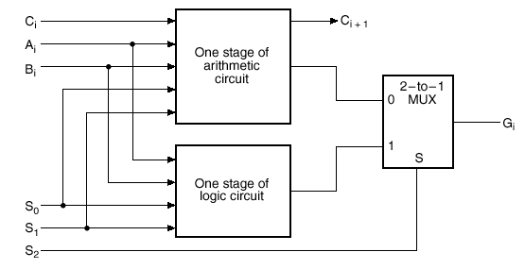
Single Stage ALU
Design a 1-bit Arithmetic unit
Design a 1-bit Logic unit
Combine the two units to form a 1-bit Arithmetic/Logic
Use S₂ to choose either Arithmetic or Logic Operations
Use S₁, S₀ to choose operations within each unit.
Replicate as many times to form an n-bit ALU

Slide 12
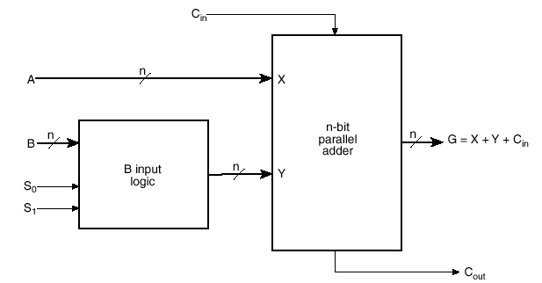
Arithmetic Circuit
The basic component of an arithmetic circuit is a:
  N-bit Ripple Carry Adder (Parallel Adder).
  By controlling the data inputs to the parallel adder, it is possible to obtain different types of arithmetic operations (C_{in} is also an input)
  Select lines S₀, S₁ can be used to control input Y. Why? How?

Slide 13
Use a MUX to Control Operand “B”
B₁
B₁
B₀
B₀
MUX
MUX
0
1
S₀
S₀
S
A₁
A₀
C₂
FA
C₁
FA
C₀
S₁
S₀

Slide 14
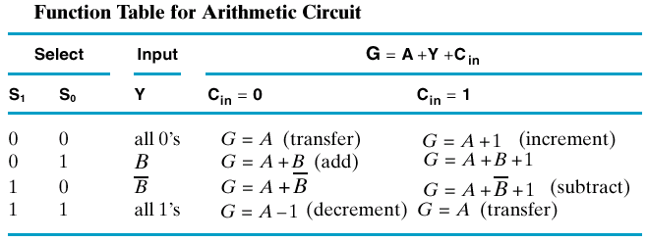
Looking Inside
By observing the Function Table we notice that we perform the following operations
  Addition, Subtraction
  Increment, Decrement
So we will need an adder
A
It is clear that operand “A” is required for all operations and therefore will not be controlled.
Operand “B” is selectively used for some operations and therefore will need to be controlled.
B
controlled

Slide 15
Looking Inside
What possible functionality can I achieve if I control the ‘Y’ Value to the n-bit Adder?
B Input
Logic
1
0
B
B’
Table → Functionality.

Slide 16
AU Implementation
Note: S₁, S₀ and C_{in} control the type of operation to be performed!!
How do we implement this?
A
1-bit
Full Adder
Straight forward “No Optimization”
0
8-to1
MUX
0
B
B
Y
B’
B’
1
1
S₁
S₀
C_{in}
Can we do better? Optimize?
Notes:
School of Engineering

Slide 17
AU Implementation
Level #1 Optimization
A
1-bit
Full Adder
0
4-to-1
MUX
B
Y
B’
1
S₁
S₀

Slide 18
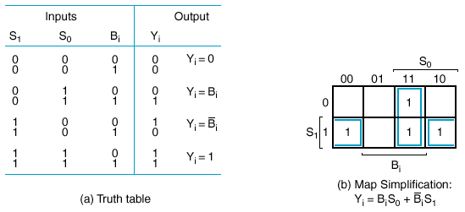
Design of B Select Logic
Can we do better?
YES: simplify the expression from the truth table using a K-Map

Slide 19
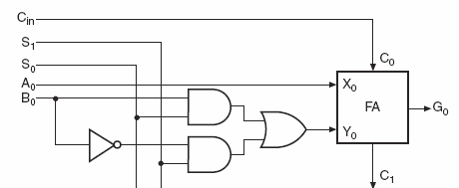
1-bit (Single Stage) Arithmetic Circuit
The B logic is nothing but a 2-to-1 Mux instead of the 4-to-1 Mux

Slide 20
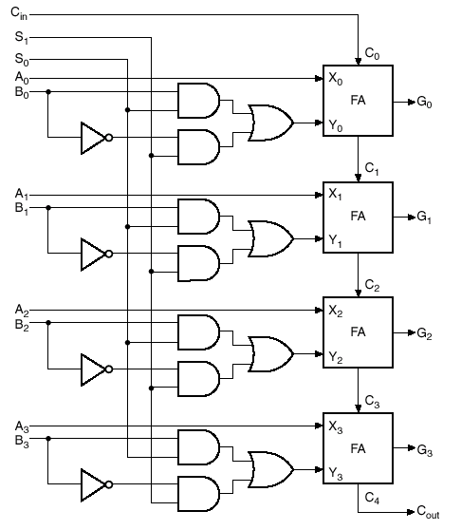
4-Bit Arithmetic Circuit
Duplicating the one stage four times will produce a 4-bit circuit

Slide 21
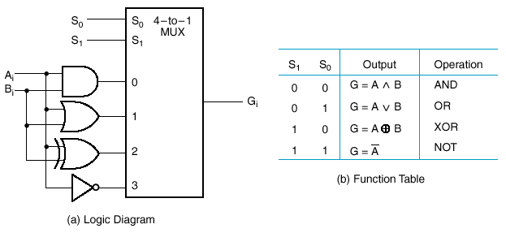
Logic Section Design
Generous number of operations

Slide 22
Arithmetic/Logic Unit
The logic circuit can be combined with the arithmetic circuit to produce an ALU.
  Selection variables S₁ and S₀ can be common to both circuits,
  A third selection variable S₂ can be used to differentiate between the logic and arithmetic operations.

Slide 23
One Stage Arithmetic Circuit

Slide 24
One Stage Logic Circuit

Slide 25
One Stage ALU
Mux to choose Arithmetic or Logic

Slide 26
N-bit ALU

Slide 27
n-bit ALU
Duplicate the one stage n times!!

Slide 28
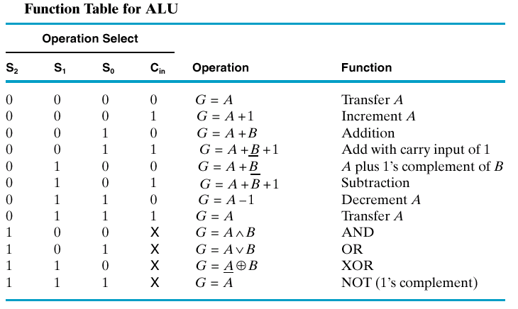
Resulting Control
The one stage ALU can provide
  8 arithmetic operations, and
  4 logic operations.

Slide 29
RTL

Slide 30
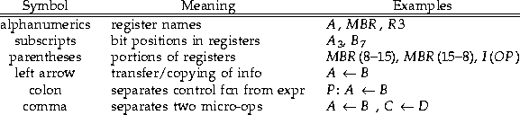
Register Transfer Language (RTL)
Register Transfer Language (RTL): used to describe CPU organization in high-level terms
RTL expressions are made up of elements which describe the registers being manipulated, and the micro-ops being performed on them
Here are the basic components of RTL expressions:

Slide 31
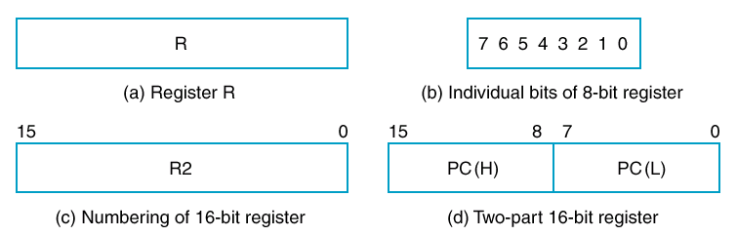
Register Transfer Language (RTL)
Registers named in uppercase
  PC, IR (instruction), R3
The operations on the data in registers are called microoperations

Slide 32
Micro-Operations
Basic operations of the datapath
  Example:
    Moving data from one register to another
    Adding the contents of two registers
    Incrementing the contents of a register
The control unit provides the signals that sequence the micro-operations in a prescribed manner
The results of a currently executing micro-operation may determine both the sequence of control signals and the sequence of future micro-operations to be executed (e.g. BNE)
A micro operation is expected to complete in one clock

Slide 33
RTL
Transfer from R1 to R2
  R2 ← R1
    R2 is destination
    R1 is source
Conditional
  If(K1 = 1) then (R2 ← R1)
    K1: R2 ← R1 as a shorter form

Slide 34
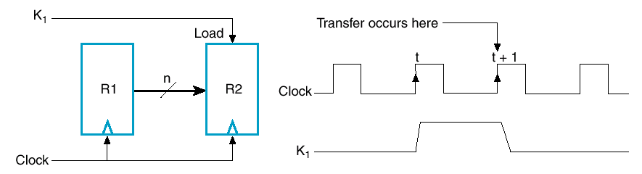
Transfer
K1: R2 ← R1
  Transfer at the clock edge
  When K1 is high
  n bits wide

Slide 35
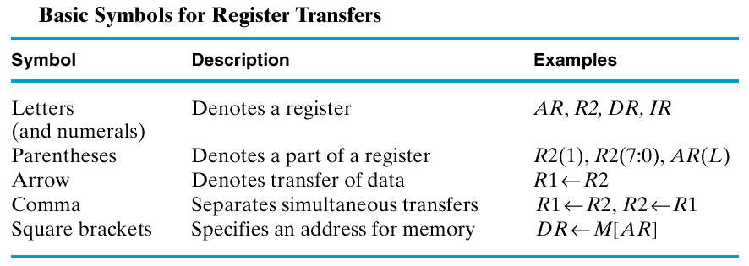
Symbols
Note memory transfers
  DR ← M[AR] (contents of Memory)

Slide 36
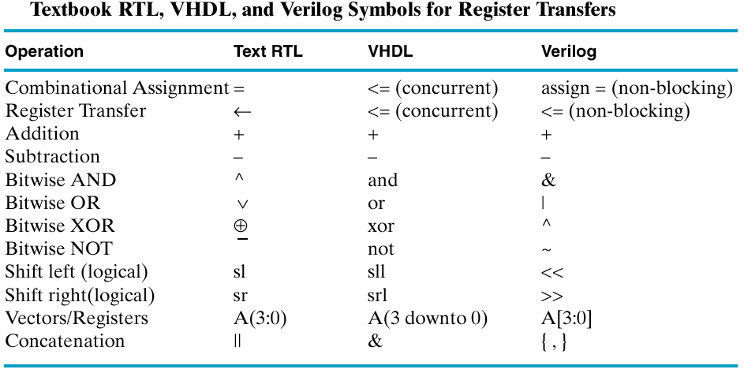
Syntax not VHDL (but similar)

Slide 37
Types of Micro-operations
Transfer – (have just looked at)
Arithmetic
Logic
Shift

Slide 38
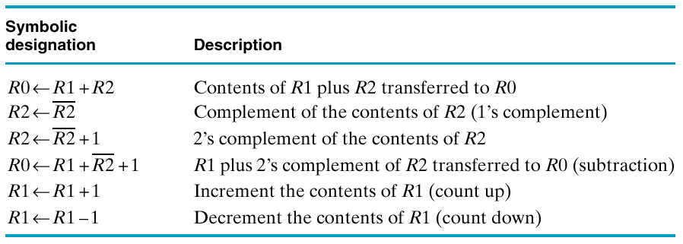
Arithmetic
Basic ops (addition, subtraction, ..)
  R0 ← R1 + R2
Subtraction by 2’s complement

Slide 39
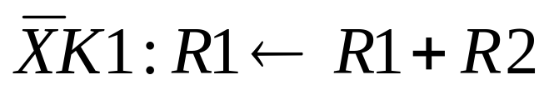
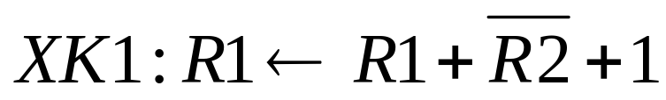
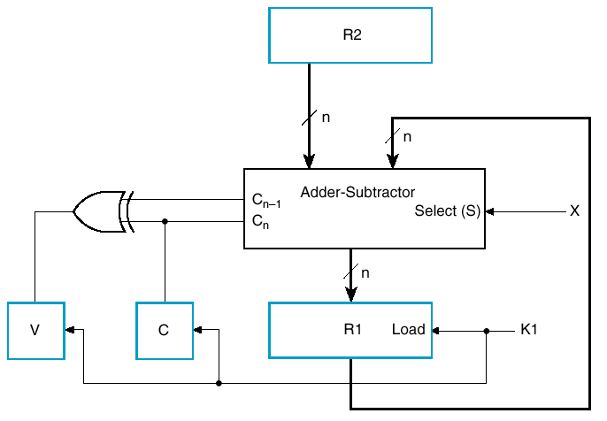
Notation is Shorthand for Hardware
Consider
and
Note: overflow
and carry registers

Slide 40
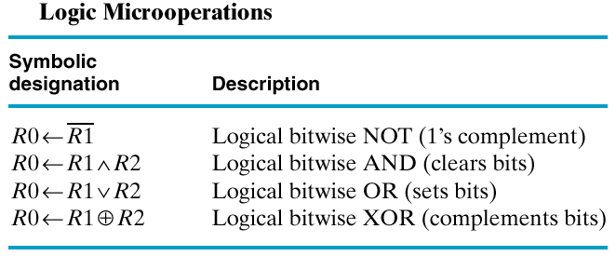
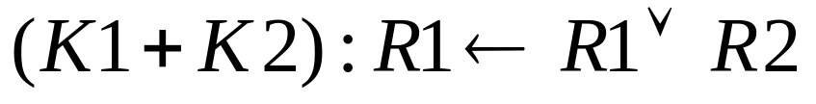
Logic Micro-operations
OR notation a little confusing
Shows two types of syntax for ORs

Slide 41
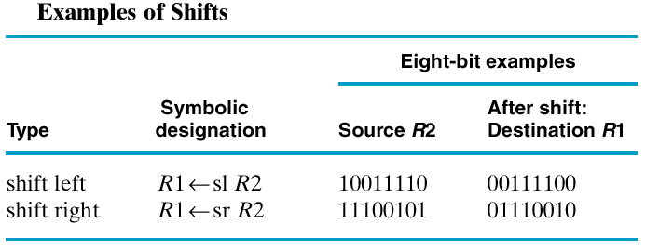
Shift Micro-Operations
Here just the basic one-bit shifts
Bit falls off the end, zero shifted in

Slide 42
Lecture End

